Slide 1
Dependency Injection and Services

Slide 2
Understanding Dependency Injection
Concept: Injecting services into components
DI Benefits: Improved modularity, Easier testing

Slide 3
Registering Services
Service Lifetimes
Scoped, Singleton, Transient
builder.Services.AddScoped<IMyService, MyService>();

Slide 4
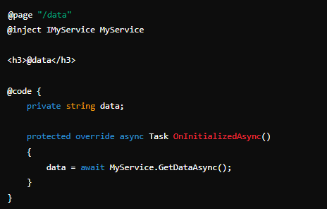
Injecting Services into Components
Using [Inject] Attribute

